Slide 1
Web and semantic web

Slide 2
What is Home Page of a web site?
A home page is generally the main page
a visitor navigating to a website from a web search engine will see,
and it may also serve as a landing page to attract visitors

Slide 3
Who invented the Web & Why?
the World Wide Web was invented by Tim Berners-Lee and Robert Cailliau in 1990.
In 1989, while working at CERN (the European Organization for Nuclear Research), both men made proposals for hypertext systems.
In 1990 they joined forces and wrote a joint proposal in which the term "World Wide Web" is used for the first time

Slide 4
Who invented the Web & Why?
And in late 1990 and early 1991, Tim Berners-Lee wrote the first web browser.
Berners-Lee went on to found the World Wide Web Consortium
which seeks to standardize and improve World Wide Web-related things such as the HTML markup language in which web pages are written.
Tim Berners-Lee invented both the HTML markup language
and the HTTP protocol used to request and transmit web pages between web servers and web browsers.

Slide 5
World Wide Web Consortium
The World Wide Web Consortium (W3C) is an international community
where Member organizations, a full-time staff, and the public work together to develop Web standards.

Slide 6
Semantic Web
An extension of the current Web that provides an easier way to find, share, reuse and combine information.
The term “Semantic Web” refers to W3C’s vision of the Web of linked data.
Semantic Web technologies enable people to create data stores on the Web, build vocabularies, and write rules for handling data.
The Semantic Web provides common formats for the interchange of data (where on the Web there is only an interchange of documents).
also provides a common language for recording how data relates to real world objects

Slide 7
Assignment
Future of sematic Web
And example of sematic web

Slide 8
Input types

Slide 9
Input Type Color
<form> Select your favorite color: <input type="color" name="favcolor"> </form>

Slide 10
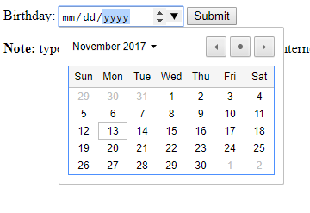
Input Type Date
<form> Birthday: <input type="date" name="bday"> </form>

Slide 11
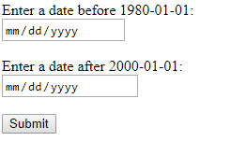
Input Type Date
<form> Enter a date before 1980-01-01: <input type="date" name="bday" max="1979-12-31"><br> Enter a date after 2000-01-01: <input type="date" name="bday" min="2000-01-02"><br> </form>

Slide 12

Input Type Datetime-local
<form> Birthday (date and time): <input type="datetime-local" name="bdaytime"> </form>

Slide 13
Input Type Month
<form> Birthday (month and year): <input type="month" name="bdaymonth"> </form>

Slide 14

Input Type Number
<form> Quantity (between 1 and 5): <input type="number" name="quantity" min="1" max="5"> </form>

Slide 15

Input Type Range
<form> <input type="range" name="points" min="0" max="10"> </form>

Slide 16

Input Type Search
<form action="/action_page.php">
Search Google:
<input type="search" name="googlesearch">
<input type="submit">
</form>

Slide 17
Input Type Tel
<form> Telephone: <input type="tel" name="usrtel"> </form>

Slide 18

Input Type Time
<form action="/action_page.php">
Select a time:
<input type="time" name="usr_time">
<input type="submit">
</form>

Slide 19
Input Type Url
<form> Add your homepage: <input type="url" name="homepage"> </form>

Slide 20

Input Type Week
<form> Select a week: <input type="week" name="week_year"> </form>

